Slide 1



Slide 2

blinkit Analysis
ABOUT THE PROJECT :
The "Blinkit Analysis Using Power BI Dashboard" project is designed to leverage data visualization and analytics to enhance decision-making capabilities within Blinkit , a leading online grocery delivery platform. This initiative involves a comprehensive analysis of sales data, customer behaviours, and operational metrics, all presented through an interactive dashboard built in Power BI. The project begins with the collection of diverse data sources, including sales transactions, customer demographics, and product information, which are meticulously cleaned and transformed to ensure accuracy and consistency.
The core of the project lies in the development of the dashboard, where various visual elements—such as bar charts, line graphs, and geographic maps—are utilized to convey key performance indicators (KPIs) in an easily digestible format.
Ultimately, the "Blinkit Analysis Using Power BI Dashboard" aims to foster a data-driven culture within the organization, improve operational efficiencies, and provide actionable insights that enhance marketing strategies and inventory management, positioning Blinkit for sustained success in a competitive market

Slide 3
blinkit Analysis
Steps in Project :
Requirement gathering / Business Requirements
Data Walkthrough
Data Connection
Data Cleaning / Quality Check
Data Modeling
Data Processing
Dax Calculations
Dashboard Lay Outing
Charts Development and Formating
Dashboard / Report Development
Insights Generation

Slide 4

blinkit Analysis
BUSINESS REQUIREMENTS :
To conduct a comprehensive analysis of Blinkit’s sales performance , customer satisfaction , and inventory distribution to identify key insights and opportunities for optimization various KPI’s(Key Performance Indicator) and visualizations in Power BI.
KPI REQUIREMENT :
Total Sales : The overall revenue generated from all item sold .
Average Sales : The Average revenue per sales .
Number of items : The total count of different items sold .
Average Rating : The average customer rating for items sold .

Slide 5





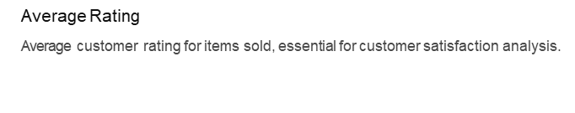

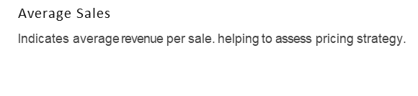
blinkit Analysis
Total Sales
Reflects overall revenue from all items sold crucial for financial health.

Slide 6
blinkit Analysis
CHART’S REQUIREMENT :
Total Sale By Fat Content :
Objective : Analyze the impact of fat content on total sales .
Additional KPI Requirement : Acess how other KPI vary with fat content .
Chart Type : Donut Chart
2. Total Sales By Item Type :
Objective : Identify the performance of different items in terms of total sales .
Additional KPI Requirements : Acess how other KPI vary with fat content .
Chart Type : Bar Chart

Slide 7
blinkit Analysis
.
I •
3. FAT CONTENT BY OUTLET FOR TOTAL SALES :
Objective : Compare total sales across different outlet segmented by fat content.
Additional KPI Requirements : Acess how other KPI vary with fat content .
Chart Type : Stacked Column Chart
4. TOTAL SALES BY OUTLET ESTABLISHEMENT :
Objective : Evaluate how age and type of establishment influence total sale .
ChartType : Line Chart
5. SALES BY OUTLET SIZE :
Objective : Analyze the correlation between outlet size and total sales .
Chart Type : Donut Chart
•
° ° °

Slide 8
blinkit Analysis
6 . SALES BY OUTLET LOCATION :
Objective : Access the geographical distribution of sales across different locations .
Char Type : Funnel Map
7. ALL METRICS BY OUTLET TYPE :
Objective : Provide a comprehensive view of all key .
Chart Type : Matrix Card
•

Slide 9
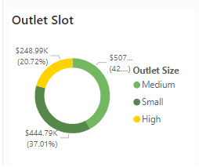
blinkit Analysis
CHART OUTCOME :
2
1
3
4
7
5
6

Slide 10
blinkit Analysis

